Slide 1

TOPIC :
The SAMSUNG Freestyle
Presented By : Group 1
Chey SreyLin, Oun Vireak, Choun Sophanon, Yi Chandara, Sari PuthiPonareay
Notes:
What product? (Introduction about the product) - Ponareay
What important feature or function that the product has? - Sophanon
how human centered design being implemented in this product - Chandara
Pros - Vikreth
and cons - Sreylin

Slide 2
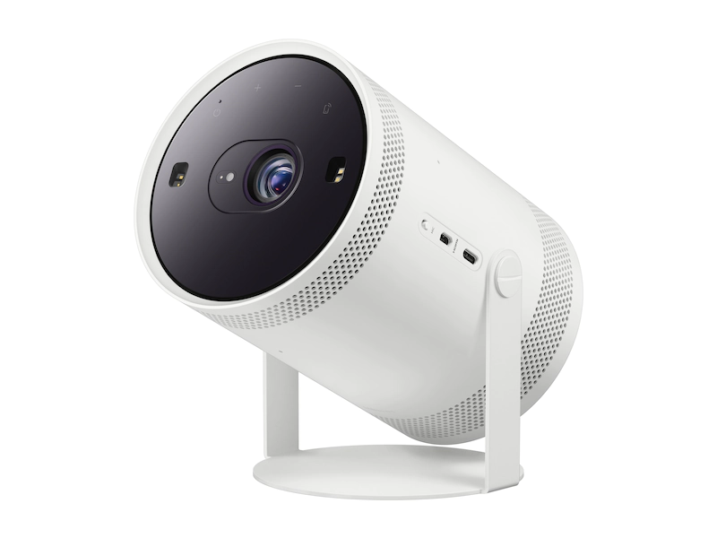
What is SAMSUNG Freestyle product ?
Notes:
What product? (Introduction about the product) - Ponareay
What important feature or function that the product has? - Sophanon
how human centered design being implemented in this product - Chandara
Pros - Vikreth
and cons - Sreylin

Slide 3
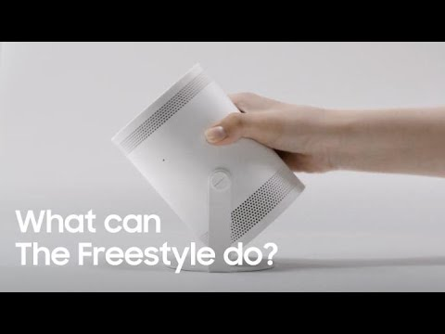
Introducing Samsung FreeStyle
Samsung FreeStyle is the New era of Projector. The Freestyle is an impressively dinky portable projector which work as a standalone stream otherwise you can hook up your smartphone, your personal computer (PC) whatever u fancy.
Freestyle is running on Tizen 6.0 Operating System (OS).
Instant set up with keystone correction, autofocus and 5 watt audio blaster in there as well(360 degree surround sound).
Despite the dinky size it can pump out massive picture full HD resolution.

Slide 4

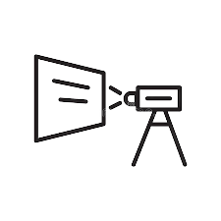

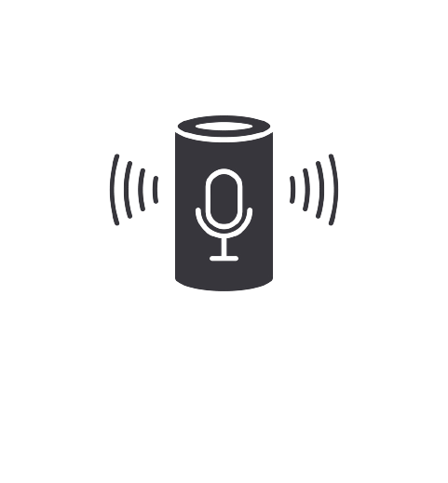
Featuring
Automatically adjust to color according to the wall
Providing a perfectly proportional image every time
Analyzing the music to pair visual effects that can be projected on the wall, floors and anywhere else
Smart voice assistant
Notes:
The first portable projector to include far-field voice control allowing user to choose their favorite voice assistants for using the device hand-free.
Including the ambient light mode, which automatically changing the display screen according to the surroundings
The Freestyle adjusts and calibrates the image based on the color of the wall on which it’s projected.
There’s more. It also takes advantage of keystone correction and auto-leveling. These technologies, combined, deliver a seamless user experience with no complicated setup process standing between you and your entertainment.
https://www.sammobile.com/news/our-first-look-at-the-freestyle-samsung-most-fun-product-yet/
https://news.samsung.com/us/samsung-freestyle-portable-screen-entertainment-ces2022/#:~:text=The%20Freestyle%20offers%20Smart%20TV,Android%20and%20iOS%20mobile%20devices.

Slide 5
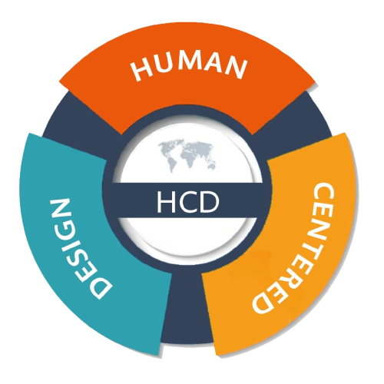
AI Human center designed features
The first portable projector to include far-field voice control via voice assistants: Bixby
Including the ambient light mode, which automatically adjusting the display screen according to the surroundings.
The Freestyle adjusts and calibrates the image based on the color of the wall.
It also takes advantage of keystone correction and auto-leveling.
Notes:
The first portable projector to include far-field voice control allowing user to choose their favorite voice assistants for using the device hand-free.
Including the ambient light mode, which automatically changing the display screen according to the surroundings
The Freestyle adjusts and calibrates the image based on the color of the wall on which it’s projected.
There’s more. It also takes advantage of keystone correction and auto-leveling. These technologies, combined, deliver a seamless user experience with no complicated setup process standing between you and your entertainment.
https://www.sammobile.com/news/our-first-look-at-the-freestyle-samsung-most-fun-product-yet/
https://news.samsung.com/us/samsung-freestyle-portable-screen-entertainment-ces2022/#:~:text=The%20Freestyle%20offers%20Smart%20TV,Android%20and%20iOS%20mobile%20devices.

Slide 6
Pros of SAMSUNG Freestyle product
The 180 degree design gives you the flexibility to point
The projector optimizes screen size, auto-focuses and level the image even pointed on an angle.
The speaker sound waves in every direction for a deeply immersives and cinematic audio experience.

Slide 7
Cons of SAMSUNG Freestyle product
Not as bright as some latest generation compact projectors
No 3.5mm audio input
Does not accept a 4K signal

Slide 8
REFERENCE
AI Human Centered Design on Freestyle Resources:
https://www.sammobile.com/news/our-first-look-at-the-freestyle-samsung-most-fun-product-yet/
https://news.samsung.com/us/samsung-freestyle-portable-screen-entertainment-ces2022/#:~:text=The%20Freestyle%20offers%20Smart%20TV,Android%20and%20iOS%20mobile%20devices.
Video of Samsung Freestyle:
https://www.youtube.com/watch?v=6lnY8oqVh3A
Inspire from:
https://userguiding.com/blog/human-centered-design/
Introducing of The Samsung FreeStyle resource:
https://www.trustedreviews.com/reviews/samsung-freestyle-review
https://www.samsung.com/us/televisions-home-theater/tvs/portable-projector/the-freestyle-sp-lsp3blaxza/#reviews

